Slide 1
Titanic Dataset Analysis Report (EDA)
Submited by :
Febee Grace J

Slide 2
1. Introduction
This project explores the Titanic dataset using Exploratory Data Analysis techniques. The goal is to understand what factors influenced passenger survival during the disaster using visual patterns and statistical summaries.
Dataset Overview
The dataset contains passenger information such as:
Age
Gender
Passenger class
Fare
Survival status

Slide 3
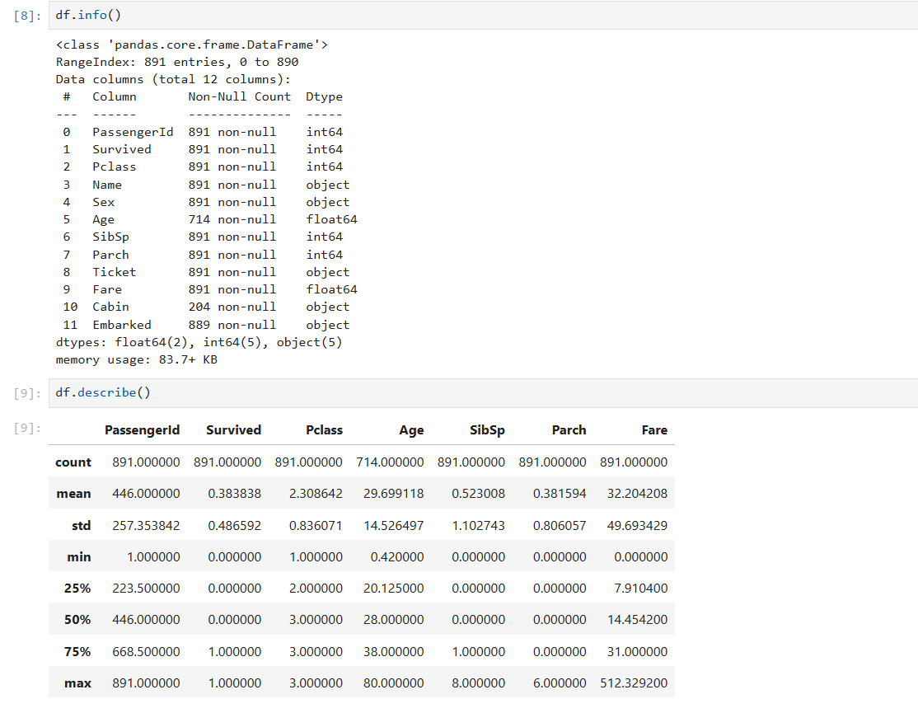
Initial Data Check
Basic functions like info() and describe() were used to understand:
*Data types
*Missing values
*Distribution of numerical features
Key observation:
The dataset contains both numerical and categorical variables, making it suitable for mixed analysis.

Slide 4
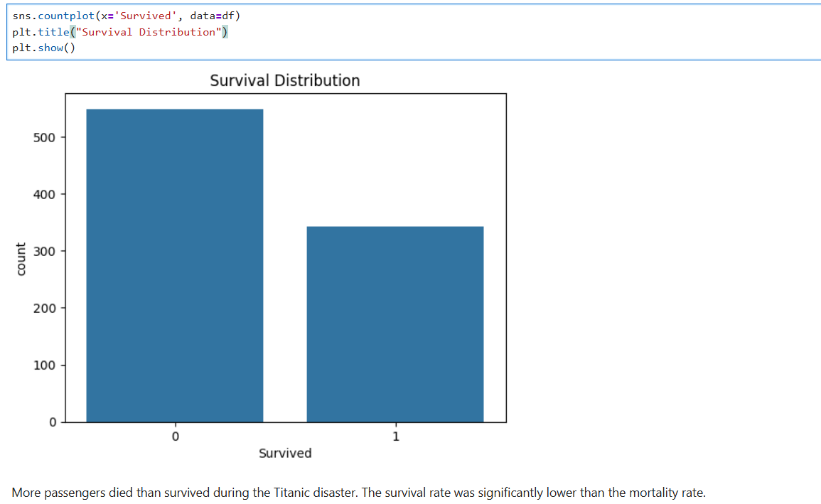
Survival Pattern Analysis
The survival distribution shows that fewer passengers survived compared to those who did not.
Insight:
The survival rate was generally low due to the scale of the disaster.

Slide 5
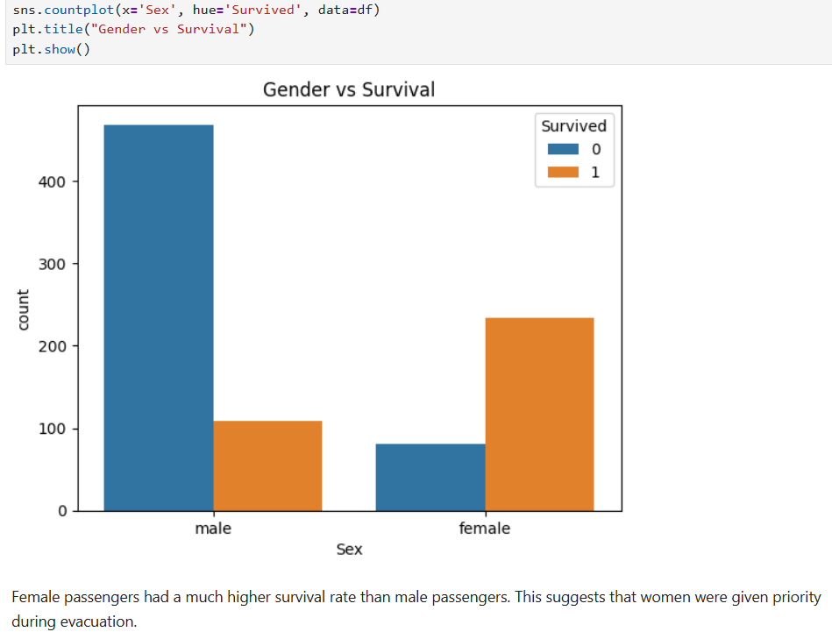
Gender Influence
Gender was strongly associated with survival.
Insight:
Females had a significantly higher survival rate than males, indicating priority for evacuation.

Slide 6
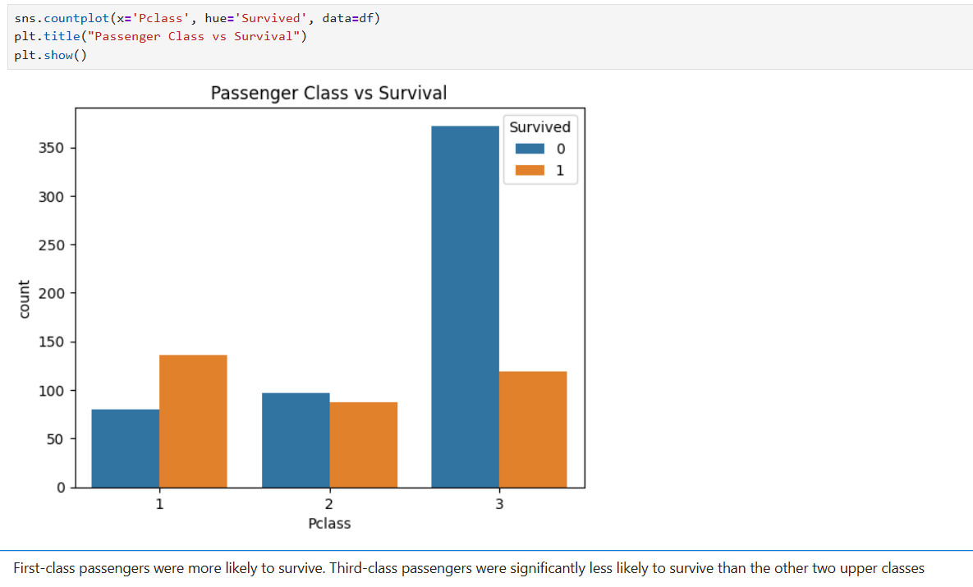
Passenger Class Effect
Passenger class strongly influenced survival chances.
Insight:
First-class passengers had better survival probability than second and third class passengers.

Slide 7
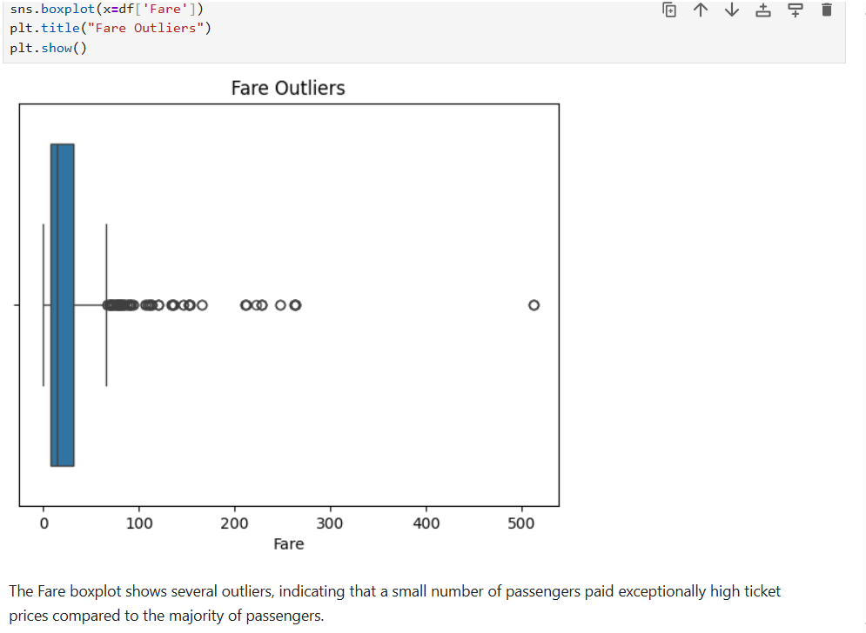
Fare Analysis
Fare distribution was highly uneven.
Insight:
Most passengers paid low fares, but a small group paid very high fares, creating outliers. These likely represent premium-class tickets.

Slide 8
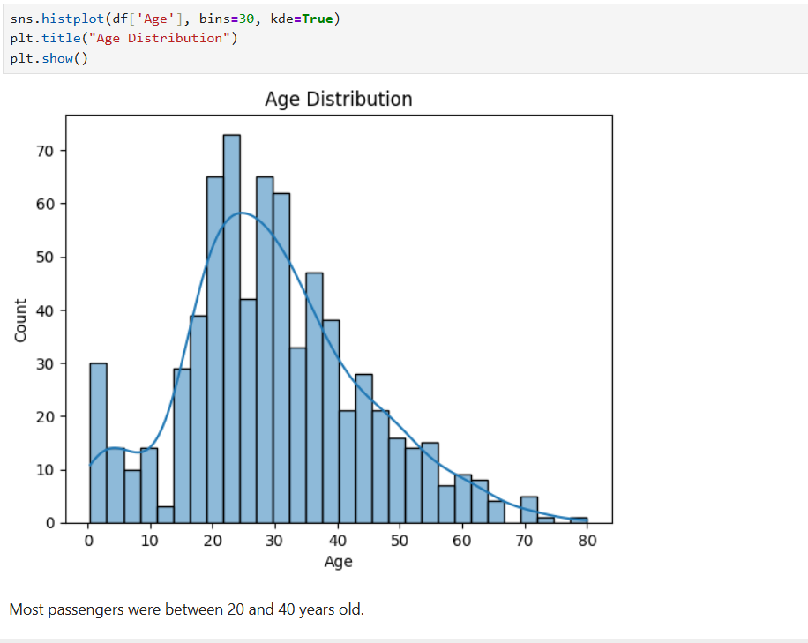
Age Distribution
Most passengers were young adults.
Insight:
The majority of passengers were between 20–40 years old, with fewer children and elderly passengers.

Slide 9
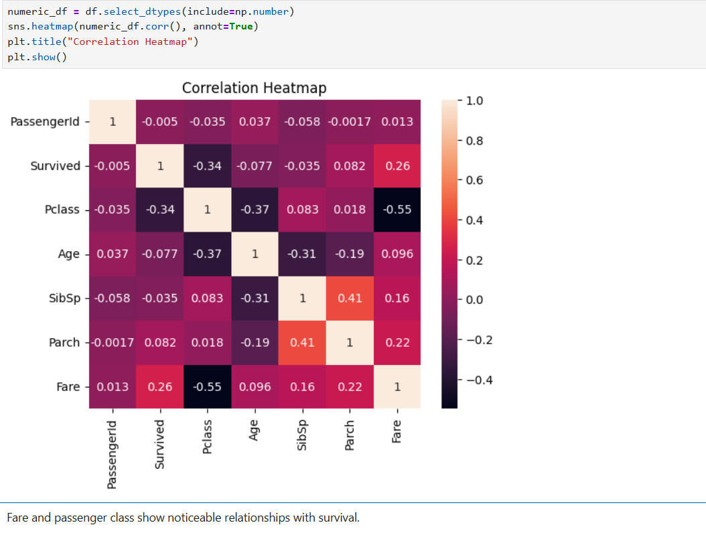
Relationship Analysis
Correlation analysis showed:
Fare and passenger class are related
Passenger class is linked to survival probability

Slide 10
Final Insights and Conclusion
Insights
Gender was the strongest survival factor
Socio-economic status influenced survival chances
Class and fare were closely linked
Age had less impact compared to other factors
Conclusions
EDA revealed clear patterns in survival behaviour. Social class, gender, and ticket fare played a major role in determining survival outcomes during the Titanic disaster.

